Slide 1
Chapter 1: Introduction

Slide 2
WARM-UP TEST

Slide 3
Chapter 1: Introduction
What Operating Systems Do
Computer-System Organization
Computer-System Architecture
Operating-System Structure
Operating-System Operations
Process Management
Memory Management
Storage Management
Protection and Security
Distributed Systems
Special-Purpose Systems
Computing Environments
Open-Source Operating Systems

Slide 4
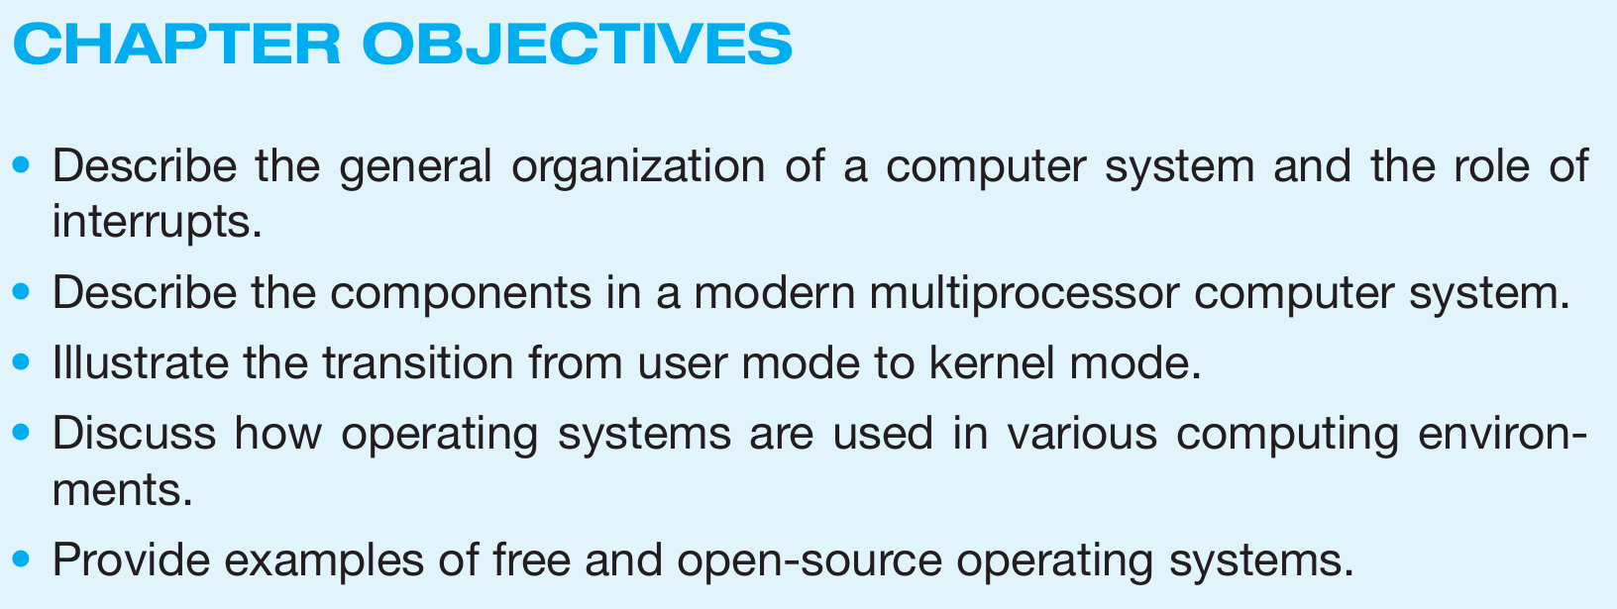
Objectives
To provide a grand tour of the major operating systems components
To provide coverage of basic computer system organization

Slide 5
What is an Operating System?
A program that acts as an intermediary between a user of a computer and the computer hardware
Operating system goals:
Execute user programs and make solving user problems easier
Make the computer system convenient to use
Use the computer hardware in an efficient manner
Notes:
Important for Exam Preparation

Slide 6
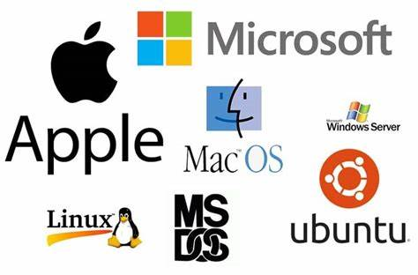

Slide 7
Mobile Operating Systems
Android
iOS
Windows Phone (no longer supported)
Server Operating Systems
Windows Server
Linux Server Editions
CentOS
Red Hat Enterprise Linux (RHEL)
SUSE Linux Enterprise Server (SLES)
Unix
AIX
HP-UX
Solaris
Embedded Operating Systems
FreeRTOS
VxWorks
QNX
Desktop Operating Systems
Windows Versions
macOS
macOS Monterey
macOS Ventura
Linux Distributions
Ubuntu
Fedora
Debian
Arch Linux
Mint
Notes:
Important for Exam Preparation

Slide 8
Other Notable Operating Systems
Chrome OS
OpenBSD
ReactOS (an open-source Windows alternative)
Real-Time Operating Systems (RTOS)
RTEMS - Real-Time Executive for Multiprocessor Systems (RTEMS)
Integrity
Nucleus
RTOS | Example Applications
RTEMS | Used in space applications, such as the NASA's Mars Rover.
Integrity | Commonly used in automotive systems for safety-critical tasks, like airbag control systems.
Nucleus | Employed in medical devices, such as patient monitoring systems and infusion pumps.
Notes:
Important for Exam Preparation

Slide 9
Type of Operating System | Examples | Key Characteristics
Desktop Operating Systems | Windows 10, Windows 11, macOS Ventura, Ubuntu, Fedora | Designed for personal computers; support a wide range of applications; user-friendly interfaces.
Mobile Operating Systems | Android, iOS, Windows Phone | Optimized for mobile devices; focus on touch interfaces; often have app stores for software distribution.
Server Operating Systems | Windows Server, CentOS, Red Hat Enterprise Linux (RHEL), SUSE Linux, AIX | Tailored for server hardware; support multiple users and processes; focus on stability and performance.
Embedded Operating Systems | FreeRTOS, VxWorks, QNX | Designed for specific hardware; often real-time systems; minimal resources and tailored for specific tasks.
Real-Time Operating Systems (RTOS) | RTEMS, Integrity, Nucleus | Provide deterministic response times; used in critical applications where timing is crucial.
Other Notable Operating Systems | Chrome OS, OpenBSD, ReactOS | Diverse functions; Chrome OS is web-centric, OpenBSD focuses on security, ReactOS aims to be Windows-compatible.
Notes:
Important for Exam Preparation

Slide 10
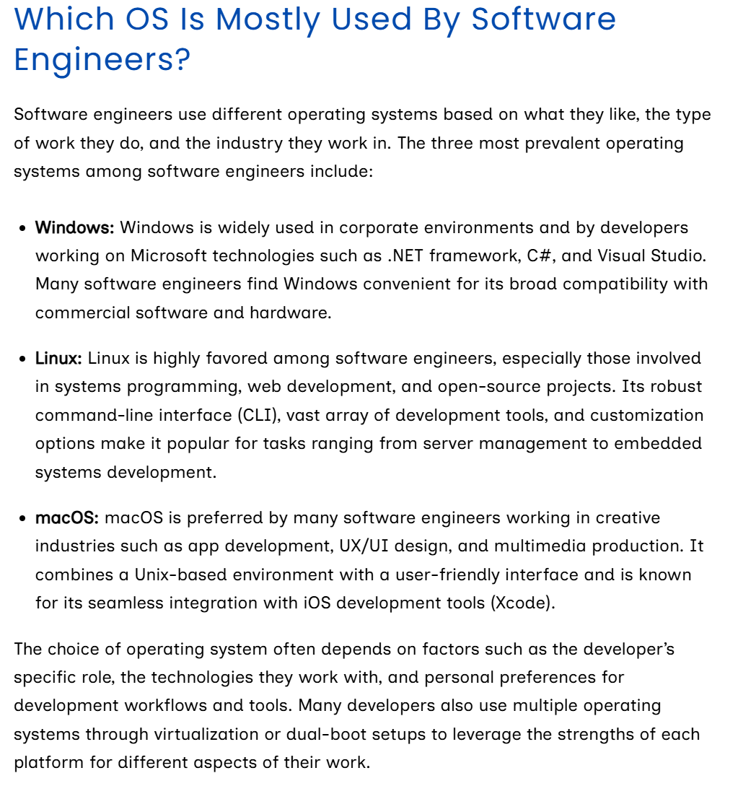

Slide 11
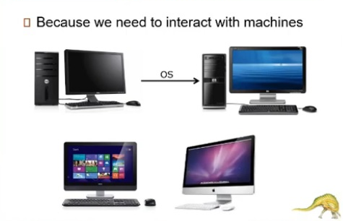
Why we use an Operating System?

Slide 12
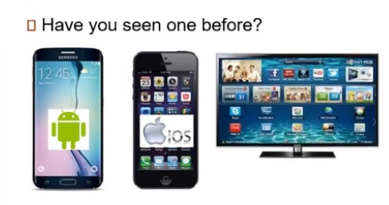

Slide 13
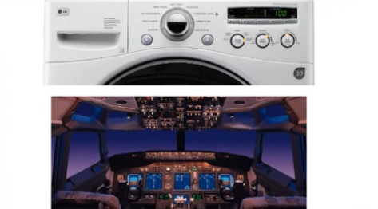

Slide 14
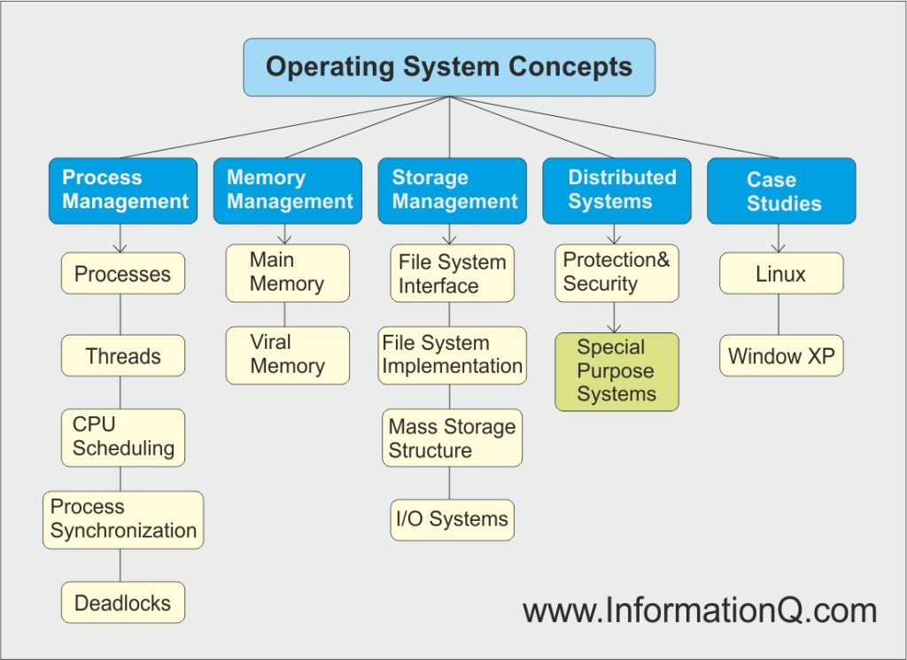
Operating System Concepts
Notes:
Important for Exam Preparation – Draw a diagram like that…

Slide 15
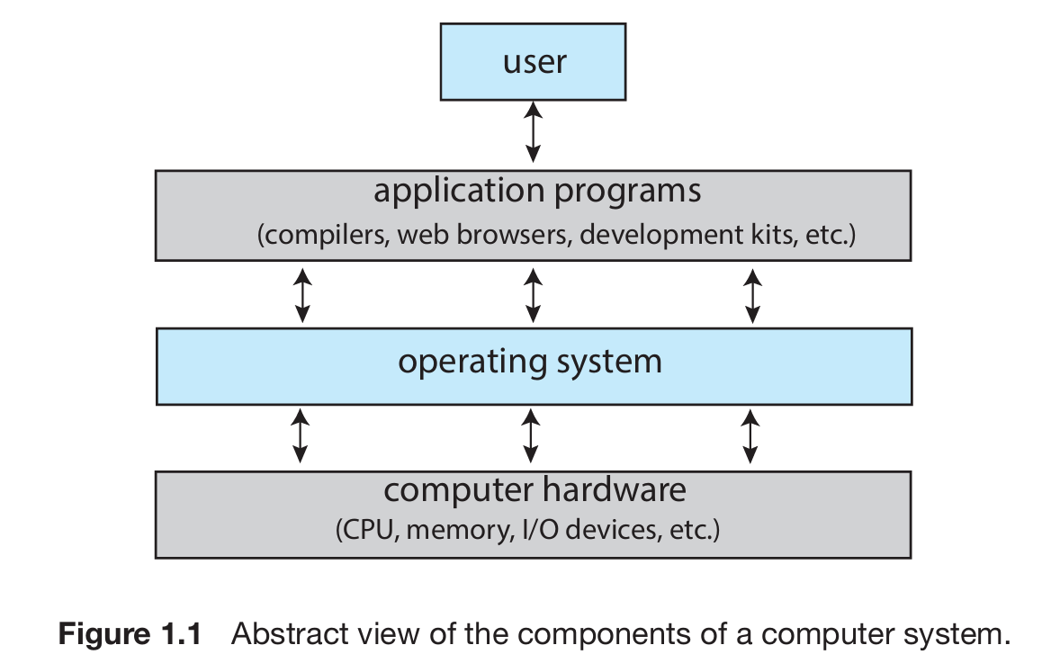
Computer System Structure
Four Components of a Computer System

Slide 16
Computer System Structure
Computer system can be divided into four components:
Hardware – provides basic computing resources
CPU, memory, I/O devices
Operating system
Controls and coordinates use of hardware among various applications and users
Application programs – define the ways in which the system resources are used to solve the computing problems of the users
Word processors, compilers, web browsers, database systems, video games
Users
People, machines, other computers

Slide 17
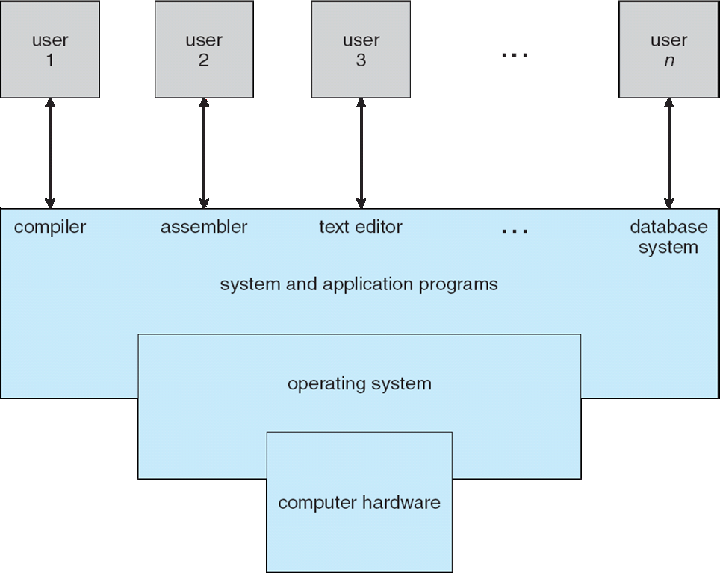
Four Components of a Computer System

Slide 18
What Operating Systems Do
Depends on the point of view
Users want convenience, ease of use
Don’t care about resource utilization
But shared computer such as mainframe or minicomputer must keep all users happy
Users of dedicate systems such as workstations have dedicated resources but frequently use shared resources from servers
Handheld computers are resource poor, optimized for usability and battery life
Some computers have little or no user interface, such as embedded computers in devices and automobiles

Slide 19
Defining OS
Nowadays, Computers are present within toasters, cars, ships, space craft, homes, and businesses. They are the basis for game machines, cable TV tuners, and industrial control systems.
Initially OS were fixed-purpose systems for military uses, such as code breaking and trajectory plotting, and governmental uses, such as census calculation. Those early computers evolved in to general-purpose, multifunction mainframes, and that’s when operating systems were born.

Slide 20
Moore’s Law about OS
Inthe1960s, Moore’s Law predicted that the number of transistors on an integrated circuit would double every 18 months, and that prediction has held true.
Computers gained in functionality and shrank in size, leading to a vast number of uses and a vast number and variety of operating systems. (See Appendix A for more details on the history of operating systems.)

Slide 21
Operating System Definition
OS is a resource allocator
Manages all resources
Decides between conflicting requests for efficient and fair resource use
OS is a control program
Controls execution of programs to prevent errors and improper use of the computer

Slide 22
Operating System Definition (Cont.)
No universally accepted definition
“Everything a vendor ships when you order an operating system” is good approximation
But varies wildly
“The one program running at all times on the computer” is the kernel. Everything else is either a system program (ships with the operating system) or an application program.

Slide 23
Computer Startup
bootstrap program is loaded at power-up or reboot
Typically stored in ROM () or EPROM (), generally known as firmware
Initializes all aspects of system
Loads operating system kernel and starts execution
Notes:
erasable programmable read-only memory

Slide 24
Type | Full Name | Characteristics | Reusability | Typical Use Cases
ROM | Read-Only Memory | Non-volatile memory that is programmed during manufacturing; data cannot be changed. | Not reusable | Firmware, embedded systems
PROM | Programmable Read-Only Memory | Non-volatile memory that can be programmed once by the user; once programmed, data cannot be changed. | Not reusable | Custom firmware applications
EPROM | Erasable Programmable Read-Only Memory | Non-volatile memory that can be erased using UV light and reprogrammed multiple times. | Reusable (after erasing) | Development and testing of firmware

Slide 25
Type | Full Name | Characteristics | Typical Use Cases
DRAM | Dynamic Random Access Memory | Needs to be refreshed thousands of times per second; slower than SRAM; used for main memory. | Primary memory in computers and laptops
SRAM | Static Random Access Memory | Faster and more reliable than DRAM; does not need to be refreshed; more expensive. | Cache memory in CPUs, routers, and other high-speed applications
SDRAM | Synchronous Dynamic RAM | Synchronized with the system clock for higher performance; used in modern computers. | Main memory in PCs, laptops, and servers
DDR SDRAM | Double Data Rate Synchronous DRAM | Transfers data on both the rising and falling edges of the clock signal; faster than SDRAM. | Main memory in modern computers and gaming systems
LPDDR | Low Power DDR | Optimized for low power consumption; used in mobile devices. | Smartphones, tablets, and other portable devices

Slide 26
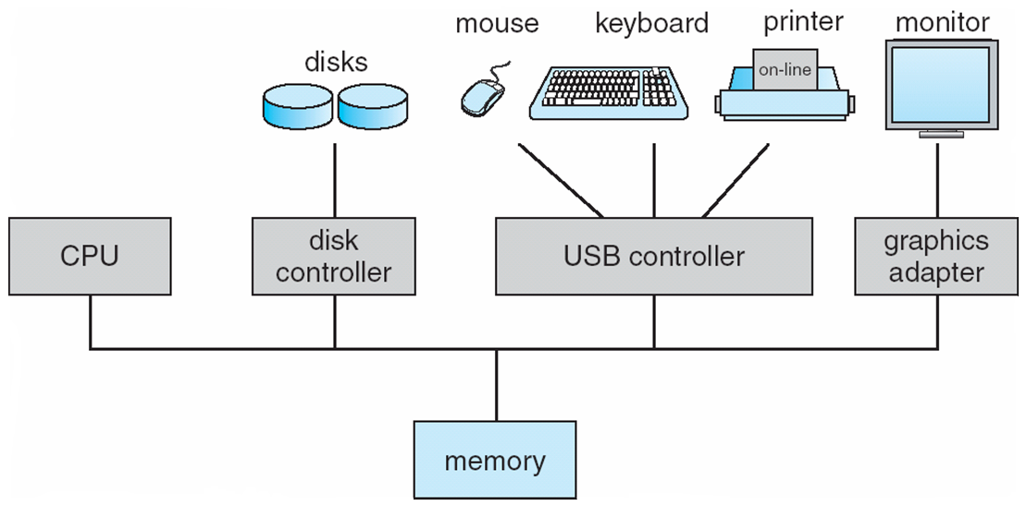
Computer System Organization
Computer-system operation
One or more CPUs, device controllers connect through common bus providing access to shared memory
Concurrent execution of CPUs and devices competing for memory cycles

Slide 27
Computer-System Operation
I/O devices and the CPU can execute concurrently
Each device controller is in charge of a particular device type
Each device controller has a local buffer
CPU moves data from/to main memory to/from local buffers
I/O is from the device to local buffer of controller
Device controller informs CPU that it has finished its operation by causing an interrupt

Slide 28
Common Functions of Interrupts
Interrupt transfers control to the interrupt service routine generally, through the interrupt vector, which contains the addresses of all the service routines
Interrupt architecture must save the address of the interrupted instruction
Incoming interrupts are disabled while another interrupt is being processed to prevent a lost interrupt
A trap is a software-generated interrupt caused either by an error or a user request
An operating system is interrupt driven

Slide 29
Interrupt Handling
The operating system preserves the state of the CPU by storing registers and the program counter
Determines which type of interrupt has occurred:
polling
vectored interrupt system
Separate segments of code determine what action should be taken for each type of interrupt

Slide 30
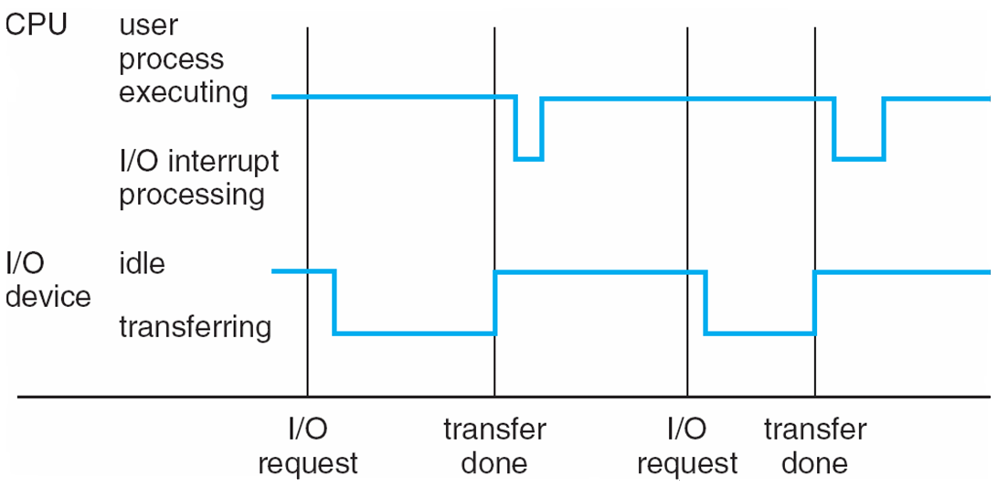
Interrupt Timeline

Slide 31
I/O Structure
After I/O starts, control returns to user program only upon I/O completion
Wait instruction idles the CPU until the next interrupt
Wait loop (contention for memory access)
At most one I/O request is outstanding at a time, no simultaneous I/O processing
After I/O starts, control returns to user program without waiting for I/O completion
System call – request to the operating system to allow user to wait for I/O completion
Device-status table contains entry for each I/O device indicating its type, address, and state
Operating system indexes into I/O device table to determine device status and to modify table entry to include interrupt

Slide 32
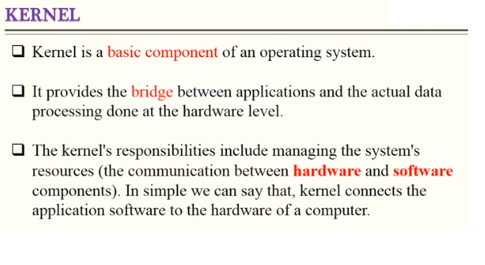
Kernal

Slide 33
Summary of Differences
Feature | Kernel | Operating System (OS)
Definition | Core component managing hardware resources | Software suite that manages hardware and software
Functionality | Resource management, process management, etc. | User interface, application management, file management, etc.
Types | Monolithic, Microkernel, Hybrid | Various (Windows, Linux, macOS, etc.)
Location | Runs in privileged mode | Runs in user mode and includes the kernel
Examples | Linux kernel, Windows NT kernel | Windows, Linux distributions, macOS

Slide 34
Direct Memory Access Structure
Used for high-speed I/O devices able to transmit information at close to memory speeds
Device controller transfers blocks of data from buffer storage directly to main memory without CPU intervention
Only one interrupt is generated per block, rather than the one interrupt per byte

Slide 35
Storage Structure
Main memory – only large storage media that the CPU can access directly
Random access
Typically volatile
Secondary storage – extension of main memory that provides large nonvolatile storage capacity
Magnetic disks – rigid metal or glass platters covered with magnetic recording material
Disk surface is logically divided into tracks, which are subdivided into sectors
The disk controller determines the logical interaction between the device and the computer

Slide 36
Storage Hierarchy
Storage systems organized in hierarchy
Speed
Cost
Volatility
Caching – copying information into faster storage system; main memory can be viewed as a cache for secondary storage

Slide 37
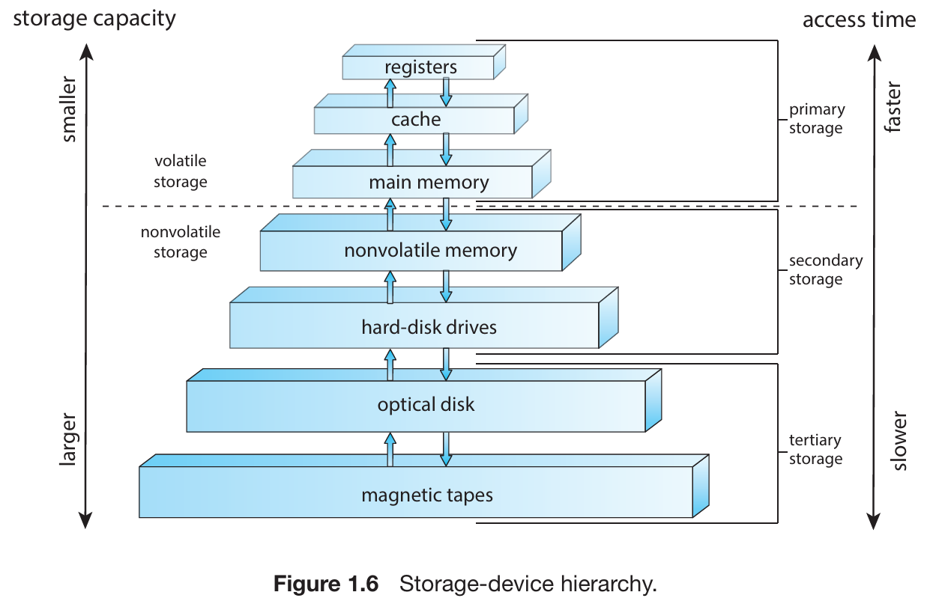
Storage-Device Hierarchy

Slide 38
Caching
Important principle, performed at many levels in a computer (in hardware, operating system, software)
Information in use copied from slower to faster storage temporarily
Faster storage (cache) checked first to determine if information is there
If it is, information used directly from the cache (fast)
If not, data copied to cache and used there
Cache smaller than storage being cached
Cache management important design problem
Cache size and replacement policy

Slide 39
Computer-System Architecture
Most systems use a single general-purpose processor (PDAs through mainframes)
Most systems have special-purpose processors as well
Multiprocessors systems growing in use and importance
Also known as parallel systems, tightly-coupled systems
Advantages include:
Increased throughput
Economy of scale
Increased reliability – graceful degradation or fault tolerance
Two types:
Asymmetric Multiprocessing
Symmetric Multiprocessing

Slide 40
Increased throughput: By increasing the number of processors, we expect to get more work done in less time. The speed-up ratio with N processors is not N, however; rather, it is less than N.
Economy of scale: Multiprocessor systems can cost less than equivalent multiple single processor systems, because they can share peripherals, mass storage, and power supplies. If several programs operate on the same set of data, it is cheaper to store those data on one disk and to have all the processors share them than to have many computers with local disks and many copies of the data.
Increased reliability: If functions can be distributed properly among several processors, then the failure of one processor will not halt the system, only slow it down.

Slide 41
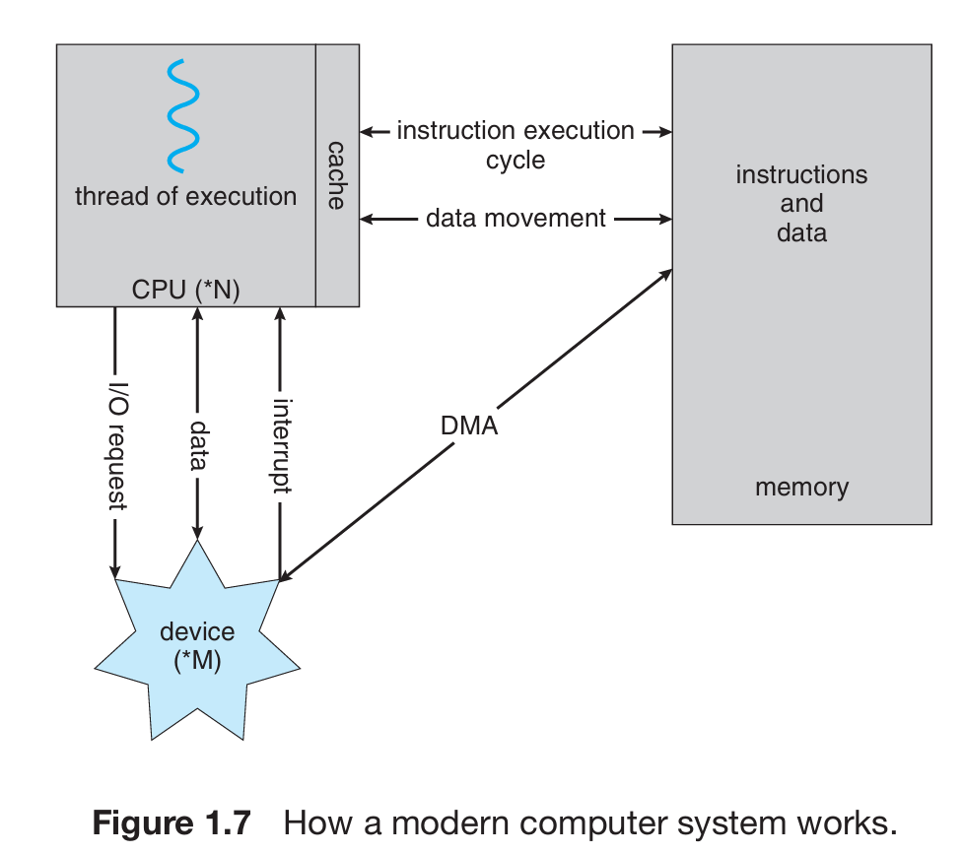
How a Modern Computer Works
A von Neumann architecture
Direct Memory Access (DMA)

Slide 42
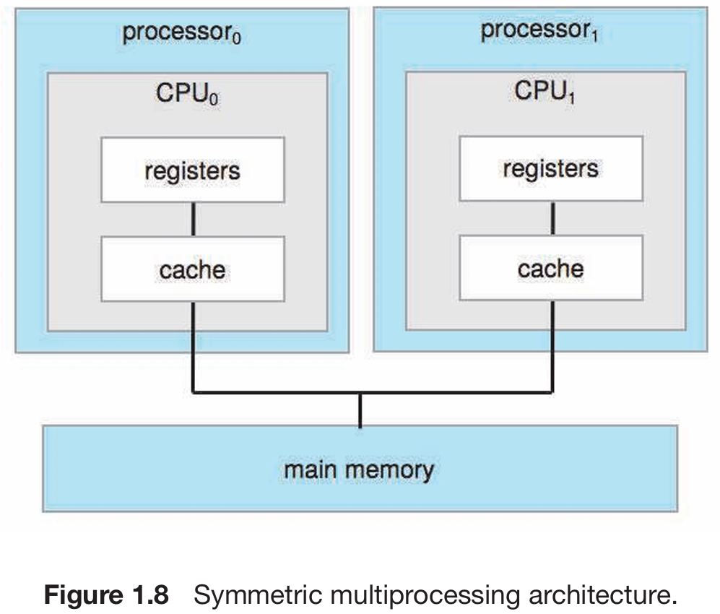
Symmetric Multiprocessing （SMP） Architecture

Slide 43
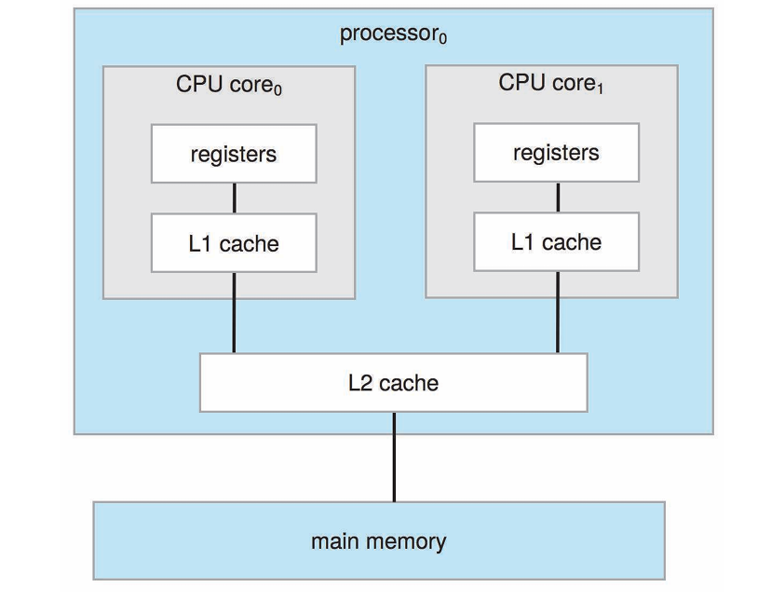
A Dual-Core Design
Figure 1.9 A dual-core design with two cores on the same chip.

Slide 44
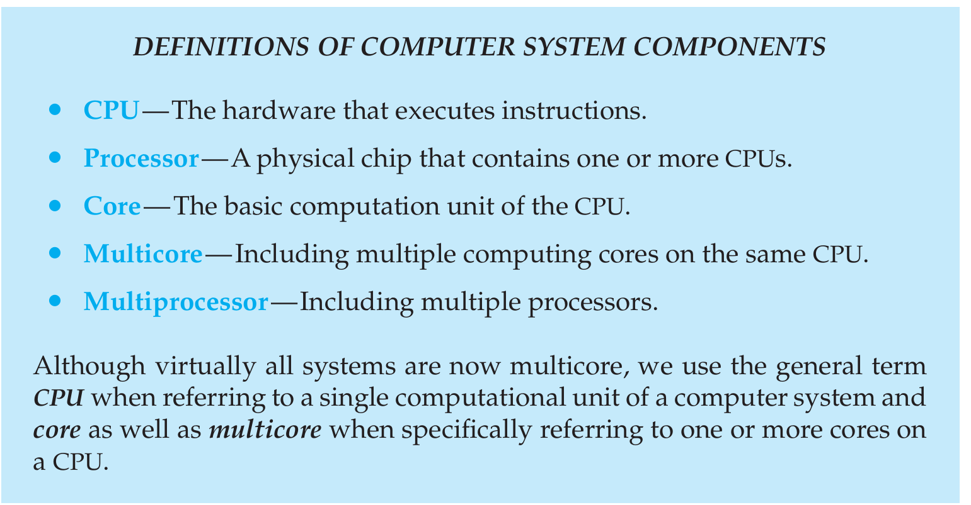

Slide 45
Summary of Differences
Feature | SMP | Dual-Core Processor
Definition | Multiple processors sharing a single memory space | Two cores on a single CPU chip
Architecture | Multiple processors can be of the same type | Two cores that can execute tasks in parallel
Scalability | Can add more processors for higher performance | Limited to two cores on the chip
Performance | Enhanced performance for multi-threaded tasks | Improved multitasking over single-core
Resource Sharing | Equal access to all resources | Shared cache and memory resources
Use Cases | Servers and high-performance workstations | Consumer laptops, desktops, and mobile devices

Slide 46
Homework
How latency and throughput is important in OS

Slide 47
Clustered Systems
A clustered system is another type of multiprocessor architecture that brings together multiple CPUs. Unlike the multiprocessor systems outlined in Section 1.3.2, clustered systems consist of two or more individual systems—referred to as nodes—each of which is typically a multicore system. These systems are generally considered loosely coupled.
It's important to note that the definition of a clustered system is not universally agreed upon; various commercial and open-source solutions strive to articulate what constitutes a clustered system and the merits of different forms. However, the widely accepted definition indicates that clustered computers share storage and are interconnected through a local-area network (LAN), or a faster interconnect such as InfiniBand.

Slide 48
Clustered Systems
Clustering is usually used to provide high-availability service
High availability provides increased reliability, which is crucial in many applications.
Clustering can be structured asymmetrically or symmetrically.
In asymmetric clustering, one machine is in hot-stand by mode while the other is running the applications.
In symmetric clustering, two or more hosts are running applications and are monitoring each other.

Slide 49
Clustered Systems
Like multiprocessor systems, but multiple systems working together
Usually sharing storage via a storage-area network (SAN)
Provides a high-availability service which survives failures
Asymmetric clustering has one machine in hot-standby mode
Symmetric clustering has multiple nodes running applications, monitoring each other
Some clusters are for high-performance computing (HPC)
Applications must be written to use parallelization

Slide 50
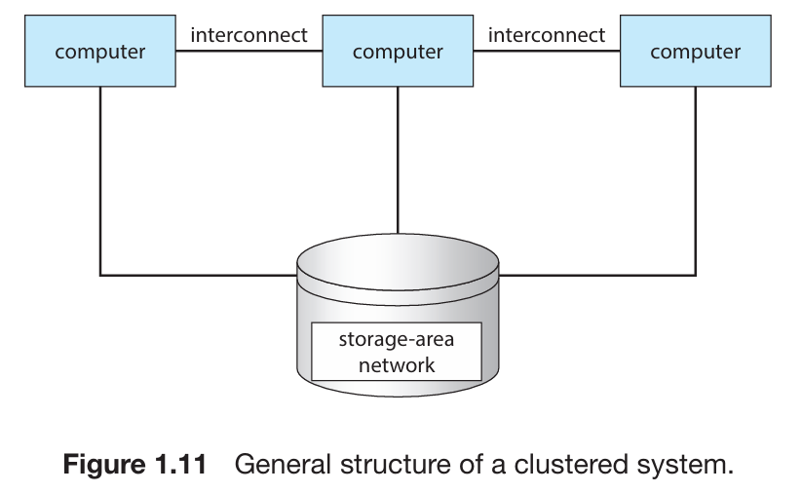
Clustered Systems

Slide 51
Operating System Structure
Multiprogramming needed for efficiency
Single user cannot keep CPU and I/O devices busy at all times
Multiprogramming organizes jobs (code and data) so CPU always has one to execute
A subset of total jobs in system is kept in memory
One job selected and run via job scheduling
When it has to wait (for I/O for example), OS switches to another job
Timesharing (multitasking) is logical extension in which CPU switches jobs so frequently that users can interact with each job while it is running, creating interactive computing
Response time should be < 1 second
Each user has at least one program executing in memory process
If several jobs ready to run at the same time  CPU scheduling
If processes don’t fit in memory, swapping moves them in and out to run
Virtual memory allows execution of processes not completely in memory

Slide 52
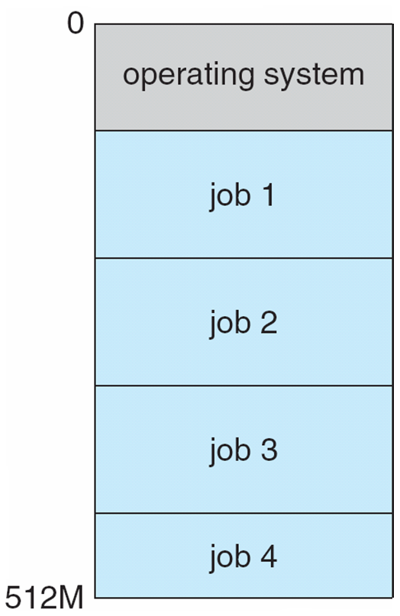
Memory Layout for Multiprogrammed System

Slide 53
Operating-System Operations
Interrupt driven by hardware
Software error or request creates exception or trap
Division by zero, request for operating system service
Other process problems include infinite loop, processes modifying each other or the operating system
Dual-mode operation allows OS to protect itself and other system components
User mode and kernel mode
Mode bit provided by hardware
Provides ability to distinguish when system is running user code or kernel code
Some instructions designated as privileged, only executable in kernel mode
System call changes mode to kernel, return from call resets it to user

Slide 54
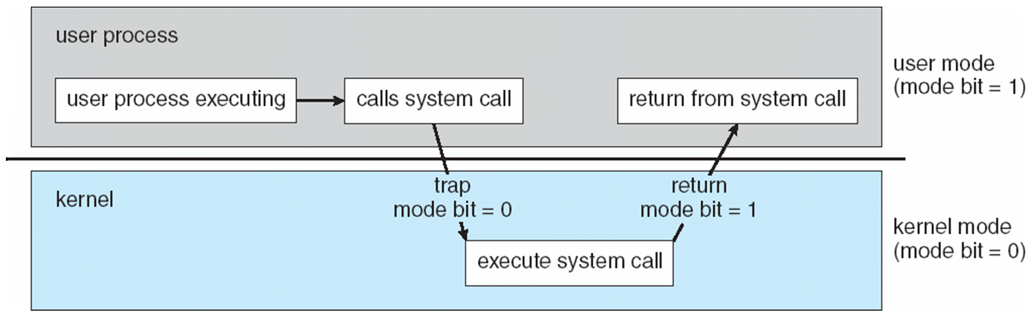
Transition from User to Kernel Mode
Timer to prevent infinite loop / process hogging resources
Set interrupt after specific period
Operating system decrements counter
When counter zero generate an interrupt
Set up before scheduling process to regain control or terminate program that exceeds allotted time

Slide 55
Process Management
A process is a program in execution. It is a unit of work within the system. Program is a passive entity, process is an active entity.
Process needs resources to accomplish its task
CPU, memory, I/O, files
Initialization data
Process termination requires reclaim of any reusable resources
Single-threaded process has one program counter specifying location of next instruction to execute
Process executes instructions sequentially, one at a time, until completion
Multi-threaded process has one program counter per thread
Typically system has many processes, some user, some operating system running concurrently on one or more CPUs
Concurrency by multiplexing the CPUs among the processes / threads

Slide 56
Process Management Activities
The operating system is responsible for the following activities in connection with process management:
Creating and deleting both user and system processes
Suspending and resuming processes
Providing mechanisms for process synchronization
Providing mechanisms for process communication
Providing mechanisms for deadlock handling

Slide 57
Memory Management
All data in memory before and after processing
All instructions in memory in order to execute
Memory management determines what is in memory when
Optimizing CPU utilization and computer response to users
Memory management activities
Keeping track of which parts of memory are currently being used and by whom
Deciding which processes (or parts thereof) and data to move into and out of memory
Allocating and deallocating memory space as needed

Slide 58
Storage Management
OS provides uniform, logical view of information storage
Abstracts physical properties to logical storage unit - file
Each medium is controlled by device (i.e., disk drive, tape drive)
Varying properties include access speed, capacity, data-transfer rate, access method (sequential or random)
File-System management
Files usually organized into directories
Access control on most systems to determine who can access what
OS activities include
Creating and deleting files and directories
Primitives to manipulate files and dirs
Mapping files onto secondary storage
Backup files onto stable (non-volatile) storage media

Slide 59
Mass-Storage Management
Usually disks used to store data that does not fit in main memory or data that must be kept for a “long” period of time
Proper management is of central importance
Entire speed of computer operation hinges on disk subsystem and its algorithms
OS activities
Free-space management
Storage allocation
Disk scheduling
Some storage need not be fast
Tertiary storage includes optical storage, magnetic tape
Still must be managed – by OS or applications
Varies between WORM (write-once, read-many-times) and RW (read-write)

Slide 60
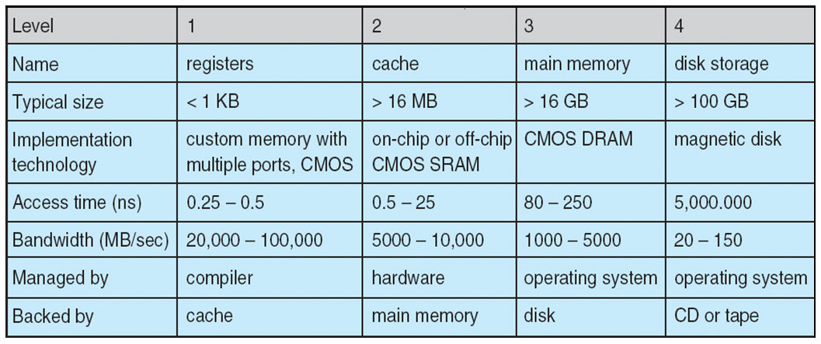
Performance of Various Levels of Storage
Movement between levels of storage hierarchy can be explicit or implicit

Slide 61
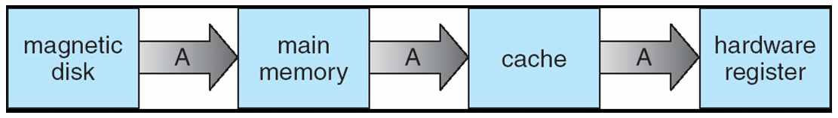
Migration of Integer A from Disk to Register
Multitasking environments must be careful to use most recent value, no matter where it is stored in the storage hierarchy
Multiprocessor environment must provide cache coherency in hardware such that all CPUs have the most recent value in their cache
Distributed environment situation even more complex
Several copies of a datum can exist
Various solutions covered in Chapter 17

Slide 62
I/O Subsystem
One purpose of OS is to hide peculiarities of hardware devices from the user
I/O subsystem responsible for
Memory management of I/O including buffering (storing data temporarily while it is being transferred), caching (storing parts of data in faster storage for performance), spooling (the overlapping of output of one job with input of other jobs)
General device-driver interface
Drivers for specific hardware devices

Slide 63
Protection and Security
Protection – any mechanism for controlling access of processes or users to resources defined by the OS
Security – defense of the system against internal and external attacks
Huge range, including denial-of-service, worms, viruses, identity theft, theft of service
Systems generally first distinguish among users, to determine who can do what
User identities (user IDs, security IDs) include name and associated number, one per user
User ID then associated with all files, processes of that user to determine access control
Group identifier (group ID) allows set of users to be defined and controls managed, then also associated with each process, file
Privilege escalation allows user to change to effective ID with more rights

Slide 64
Distributed Computing
Collection of separate, possibly heterogeneous, systems networked together
Network is a communications path
Local Area Network (LAN)
Wide Area Network (WAN)
Metropolitan Area Network (MAN)
Network Operating System provides features between systems across network
Communication scheme allows systems to exchange messages
Illusion of a single system

Slide 65
Special-Purpose Systems
Real-time embedded systems most prevalent form of computers
Vary considerable, special purpose, limited purpose OS, real-time OS
Multimedia systems
Streams of data must be delivered according to time restrictions
Handheld systems
PDAs, smart phones, limited CPU, memory, power
Reduced feature set OS, limited I/O

Slide 66
Computing Environments
Traditional computer
Blurring over time
Office environment
PCs connected to a network, terminals attached to mainframe or minicomputers providing batch and timesharing
Now portals allowing networked and remote systems access to same resources
Home networks
Used to be single system, then modems
Now firewalled, networked

Slide 67
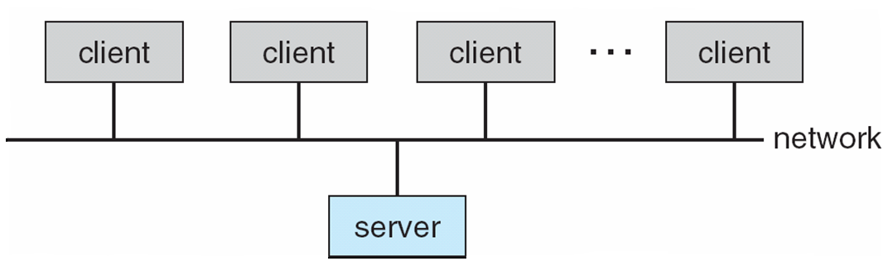
Computing Environments (Cont.)
Client-Server Computing
Dumb terminals supplanted by smart PCs
Many systems now servers, responding to requests generated by clients
Compute-server provides an interface to client to request services (i.e., database)
File-server provides interface for clients to store and retrieve files

Slide 68
Peer-to-Peer Computing
Another model of distributed system
P2P does not distinguish clients and servers
Instead all nodes are considered peers
May each act as client, server or both
Node must join P2P network
Registers its service with central lookup service on network, or
Broadcast request for service and respond to requests for service via discovery protocol
Examples include Napster and Gnutella

Slide 69
Web-Based Computing
Web has become ubiquitous
PCs most prevalent devices
More devices becoming networked to allow web access
New category of devices to manage web traffic among similar servers: load balancers
Use of operating systems like Windows 95, client-side, have evolved into Linux and Windows XP, which can be clients and servers

Slide 70
Open-Source Operating Systems
Operating systems made available in source-code format rather than just binary closed-source
Counter to the copy protection and Digital Rights Management (DRM) movement
Started by Free Software Foundation (FSF), which has “copyleft” GNU Public License (GPL)
Examples include GNU/Linux and BSD UNIX (including core of Mac OS X), and many more

Slide 71
End of Chapter 1

Slide 72
Chapter 2: Operating-System Structures

Slide 73
Chapter 2: Operating-System Structures
Operating System Services
User Operating System Interface
System Calls
Types of System Calls
System Programs
Operating System Design and Implementation
Operating System Structure
Virtual Machines
Operating System Debugging
Operating System Generation
System Boot

Slide 74
Objectives
To describe the services an operating system provides to users, processes, and other systems
To discuss the various ways of structuring an operating system
To explain how operating systems are installed and customized and how they boot

Slide 75
Operating System Services
Operating systems provide an environment for execution of programs and services to programs and users
One set of operating-system services provides functions that are helpful to the user:
User interface - Almost all operating systems have a user interface (UI).
Varies between Command-Line (CLI), Graphics User Interface (GUI), Batch
Program execution - The system must be able to load a program into memory and to run that program, end execution, either normally or abnormally (indicating error)
I/O operations - A running program may require I/O, which may involve a file or an I/O device
File-system manipulation - The file system is of particular interest. Programs need to read and write files and directories, create and delete them, search them, list file Information, permission management.

Slide 76
Operating System Services (Cont.)
Communications – Processes may exchange information, on the same computer or between computers over a network
Communications may be via shared memory or through message passing (packets moved by the OS)
Error detection – OS needs to be constantly aware of possible errors
May occur in the CPU and memory hardware, in I/O devices, in user program
For each type of error, OS should take the appropriate action to ensure correct and consistent computing
Debugging facilities can greatly enhance the user’s and programmer’s abilities to efficiently use the system

Slide 77
Operating System Services (Cont.)
Another set of OS functions exists for ensuring the efficient operation of the system itself via resource sharing
Resource allocation - When multiple users or multiple jobs running concurrently, resources must be allocated to each of them
Many types of resources - Some (such as CPU cycles, main memory, and file storage) may have special allocation code, others (such as I/O devices) may have general request and release code
Accounting - To keep track of which users use how much and what kinds of computer resources
Protection and security - The owners of information stored in a multiuser or networked computer system may want to control use of that information, concurrent processes should not interfere with each other
Protection involves ensuring that all access to system resources is controlled
Security of the system from outsiders requires user authentication, extends to defending external I/O devices from invalid access attempts
If a system is to be protected and secure, precautions must be instituted throughout it. A chain is only as strong as its weakest link.

Slide 78
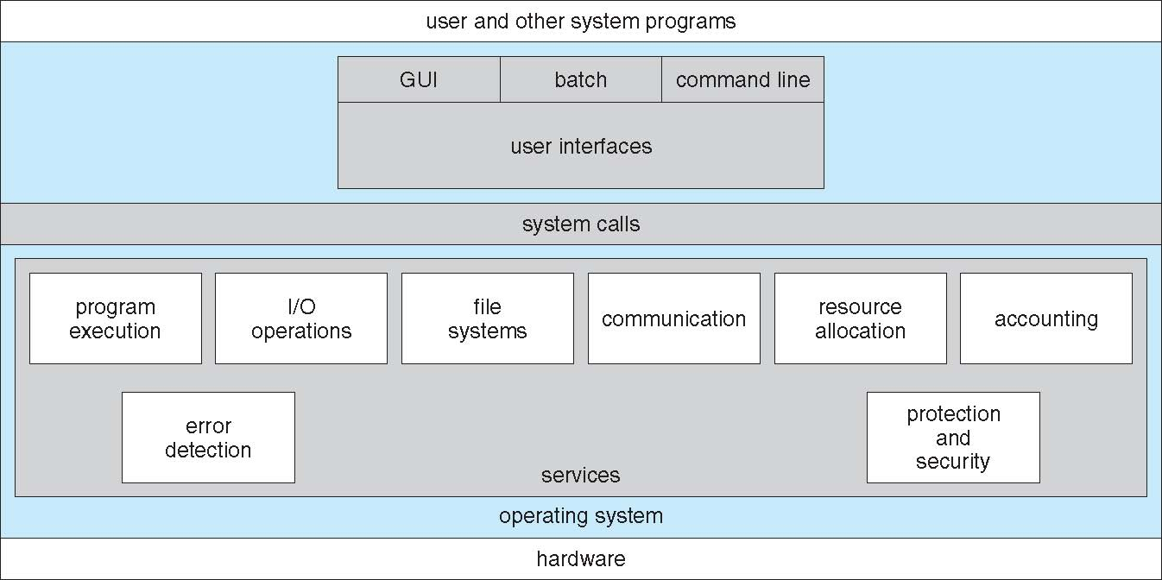
A View of Operating System Services

Slide 79
User Operating System Interface - CLI
Command Line Interface (CLI) or command interpreter allows direct command entry
Sometimes implemented in kernel, sometimes by systems program
Sometimes multiple flavors implemented – shells
Primarily fetches a command from user and executes it
Sometimes commands built-in, sometimes just names of programs
If the latter, adding new features doesn’t require shell modification

Slide 80
User Operating System Interface - GUI
User-friendly desktop metaphor interface
Usually mouse, keyboard, and monitor
Icons represent files, programs, actions, etc
Various mouse buttons over objects in the interface cause various actions (provide information, options, execute function, open directory (known as a folder)
Invented at Xerox PARC
Many systems now include both CLI and GUI interfaces
Microsoft Windows is GUI with CLI “command” shell
Apple Mac OS X as “Aqua” GUI interface with UNIX kernel underneath and shells available
Solaris is CLI with optional GUI interfaces (Java Desktop, KDE)

Slide 81
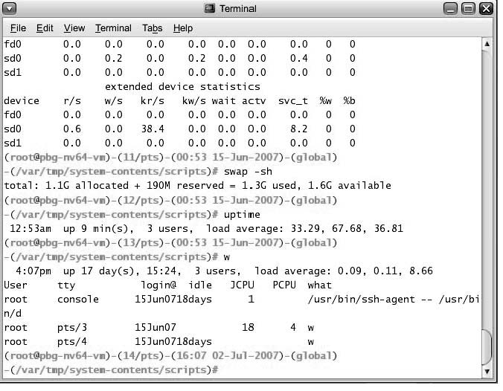
Bourne Shell Command Interpreter

Slide 82
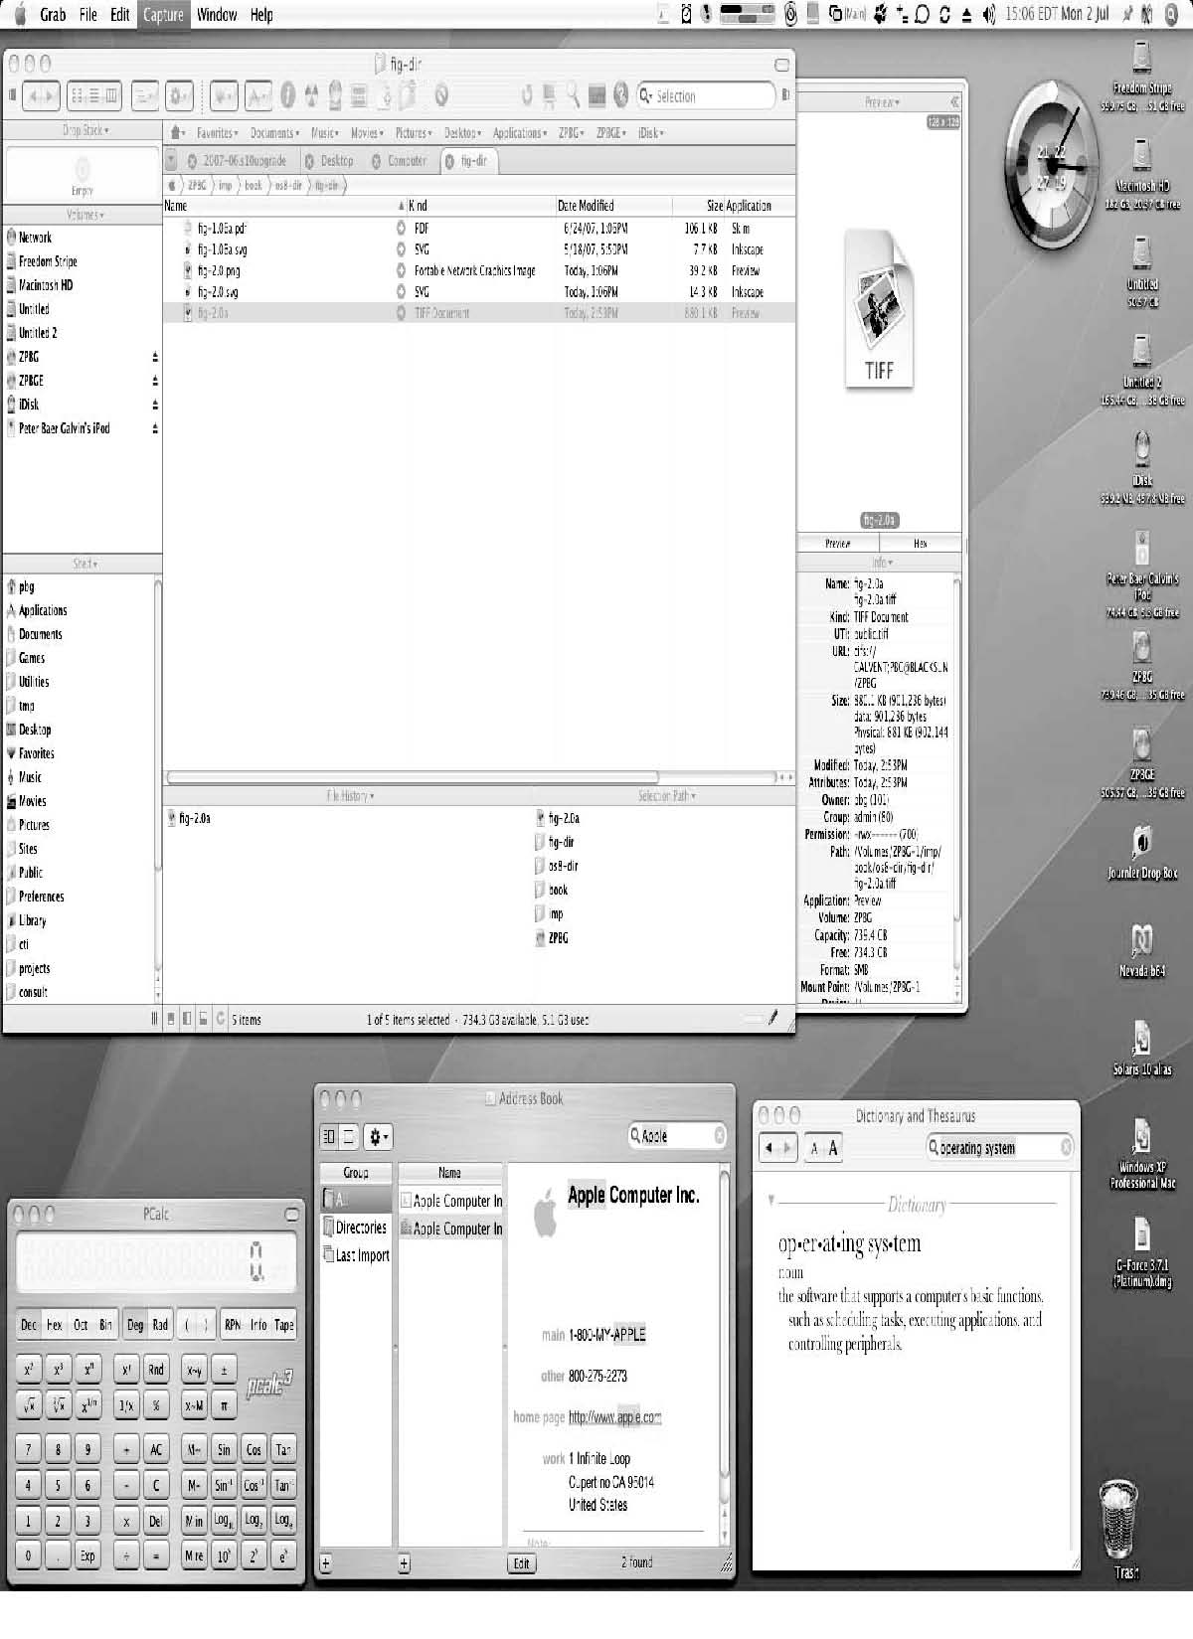
The Mac OS X GUI

Slide 83
System Calls
Programming interface to the services provided by the OS
Typically written in a high-level language (C or C++)
Mostly accessed by programs via a high-level Application Program Interface (API) rather than direct system call use
Three most common APIs are Win32 API for Windows, POSIX API for POSIX-based systems (including virtually all versions of UNIX, Linux, and Mac OS X), and Java API for the Java virtual machine (JVM)
Why use APIs rather than system calls?
(Note that the system-call names used throughout this text are generic)

Slide 84
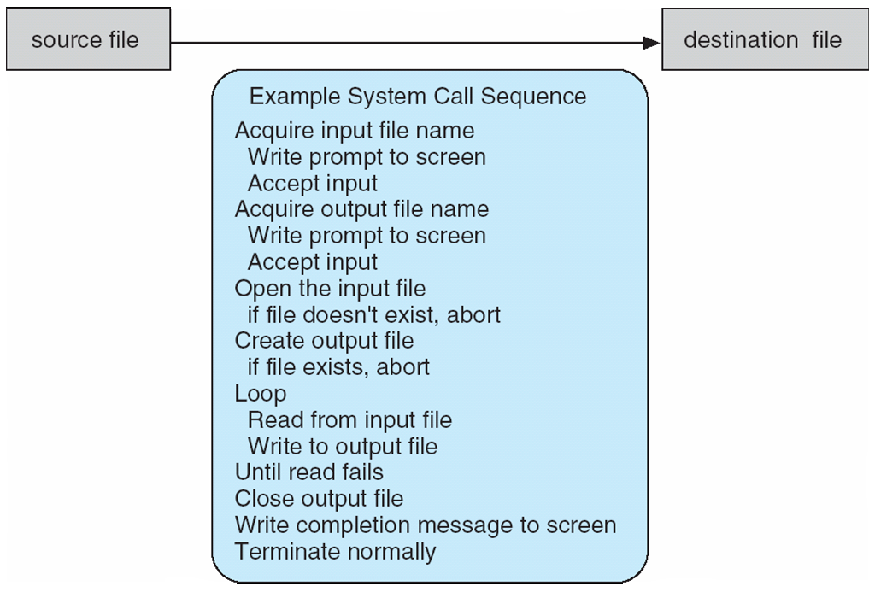
Example of System Calls
System call sequence to copy the contents of one file to another file

Slide 85
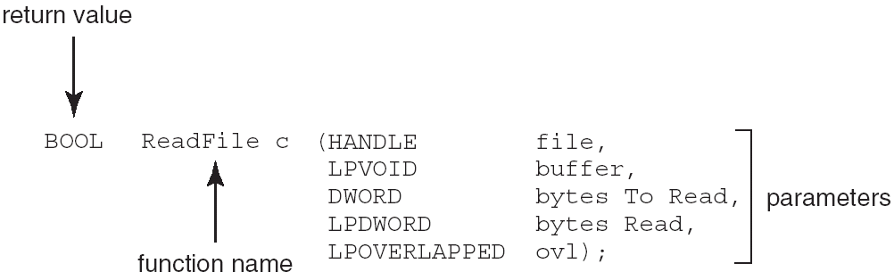
Example of Standard API
Consider the ReadFile() function in the
Win32 API—a function for reading from a file
A description of the parameters passed to ReadFile()
HANDLE file—the file to be read
LPVOID buffer—a buffer where the data will be read into and written from
DWORD bytesToRead—the number of bytes to be read into the buffer
LPDWORD bytesRead—the number of bytes read during the last read
LPOVERLAPPED ovl—indicates if overlapped I/O is being used

Slide 86
System Call Implementation
Typically, a number associated with each system call
System-call interface maintains a table indexed according to these numbers
The system call interface invokes intended system call in OS kernel and returns status of the system call and any return values
The caller need know nothing about how the system call is implemented
Just needs to obey API and understand what OS will do as a result call
Most details of OS interface hidden from programmer by API
Managed by run-time support library (set of functions built into libraries included with compiler)

Slide 87
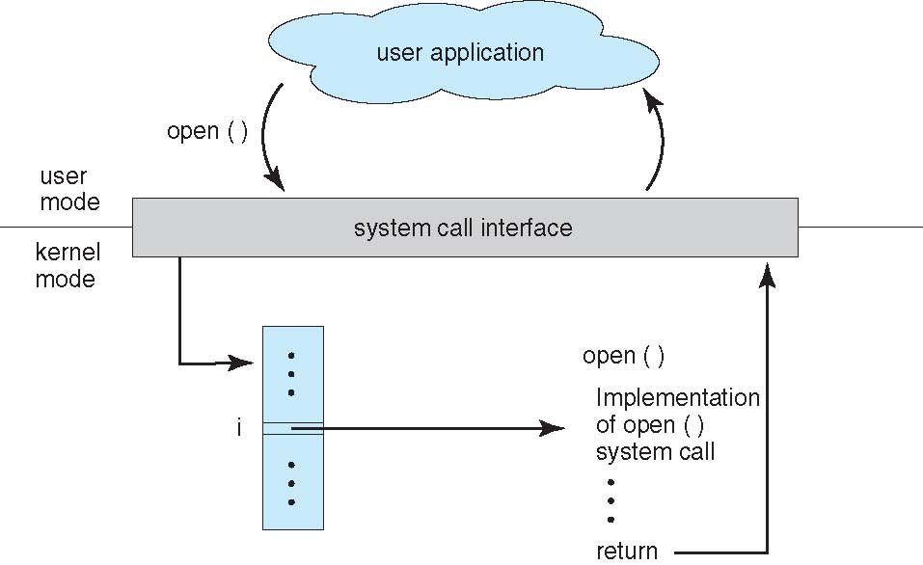
API – System Call – OS Relationship

Slide 88
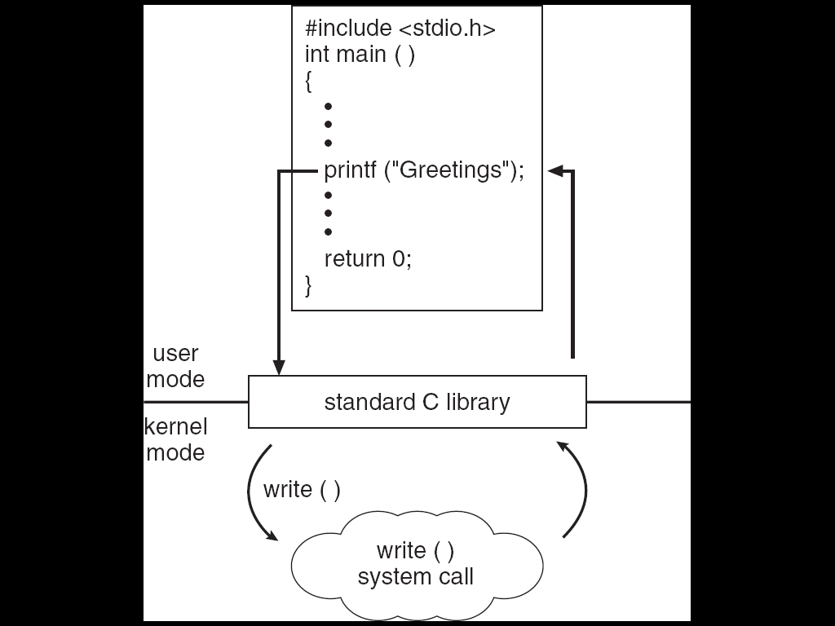
Standard C Library Example
C program invoking printf() library call, which calls write() system call

Slide 89
System Call Parameter Passing
Often, more information is required than simply identity of desired system call
Exact type and amount of information vary according to OS and call
Three general methods used to pass parameters to the OS
Simplest: pass the parameters in registers
In some cases, may be more parameters than registers
Parameters stored in a block, or table, in memory, and address of block passed as a parameter in a register
This approach taken by Linux and Solaris
Parameters placed, or pushed, onto the stack by the program and popped off the stack by the operating system
Block and stack methods do not limit the number or length of parameters being passed

Slide 90
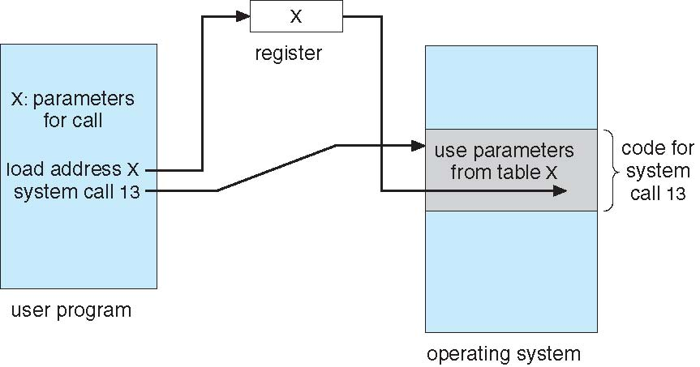
Parameter Passing via Table

Slide 91
Types of System Calls
Process control
end, abort
load, execute
create process, terminate process
get process attributes, set process attributes
wait for time
wait event, signal event
allocate and free memory
File management
create file, delete file
open, close file
read, write, reposition
get and set file attributes

Slide 92
Types of System Calls (Cont.)
Device management
request device, release device
read, write, reposition
get device attributes, set device attributes
logically attach or detach devices
Information maintenance
get time or date, set time or date
get system data, set system data
get and set process, file, or device attributes
Communications
create, delete communication connection
send, receive messages
transfer status information
attach and detach remote devices

Slide 93
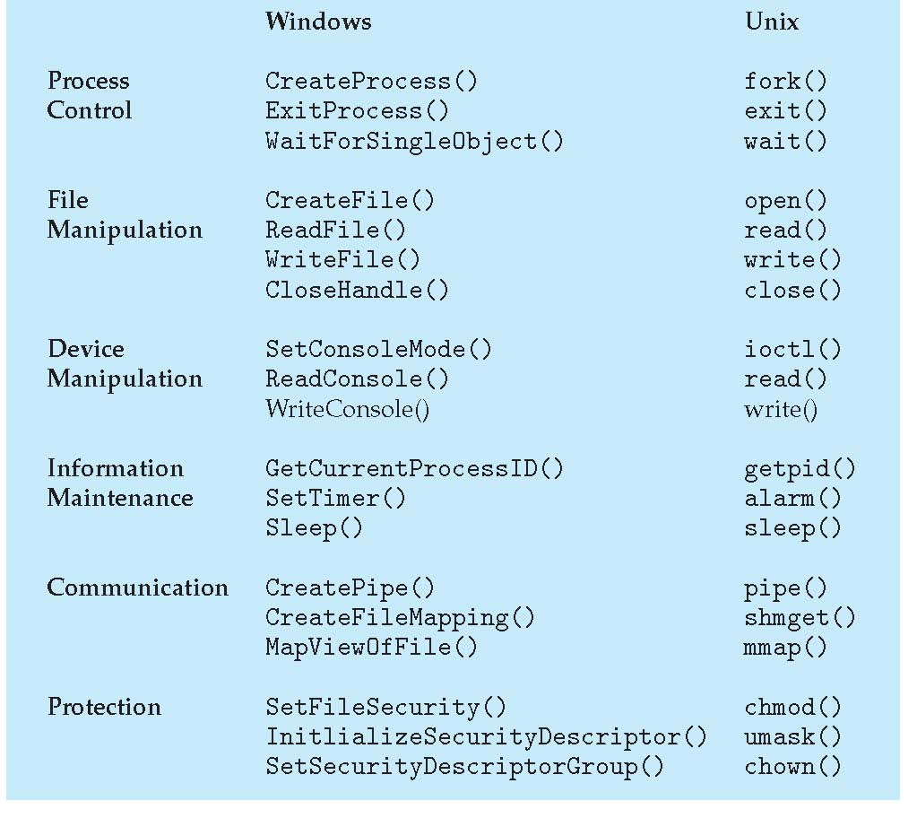
Examples of Windows and Unix System Calls

Slide 94
Example: MS-DOS
Single-tasking
Shell invoked when system booted
Simple method to run program
No process created
Single memory space
Loads program into memory, overwriting all but the kernel
Program exit -> shell reloaded

Slide 95
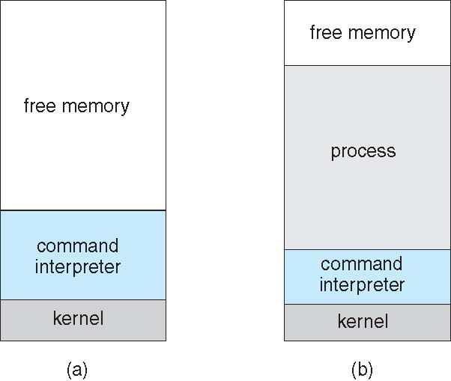
MS-DOS execution
(a) At system startup (b) running a program

Slide 96
Example: FreeBSD
Unix variant
Multitasking
User login -> invoke user’s choice of shell
Shell executes fork() system call to create process
Executes exec() to load program into process
Shell waits for process to terminate or continues with user commands
Process exits with code of 0 – no error or > 0 – error code

Slide 97
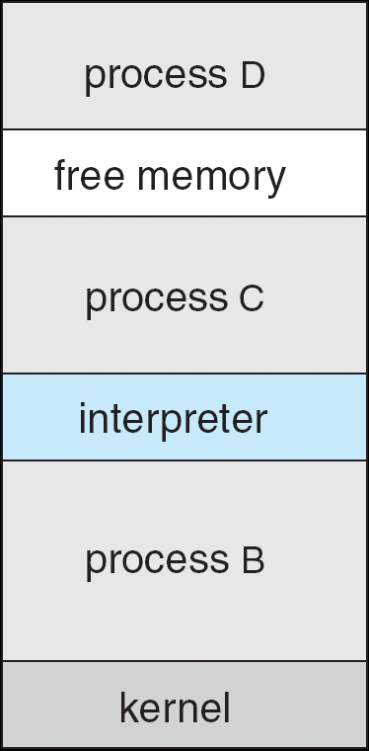
FreeBSD Running Multiple Programs

Slide 98
System Programs
System programs provide a convenient environment for program development and execution. They can be divided into:
File manipulation
Status information
File modification
Programming language support
Program loading and execution
Communications
Application programs
Most users’ view of the operation system is defined by system programs, not the actual system calls

Slide 99
System Programs
Provide a convenient environment for program development and execution
Some of them are simply user interfaces to system calls; others are considerably more complex
File management - Create, delete, copy, rename, print, dump, list, and generally manipulate files and directories
Status information
Some ask the system for info - date, time, amount of available memory, disk space, number of users
Others provide detailed performance, logging, and debugging information
Typically, these programs format and print the output to the terminal or other output devices
Some systems implement a registry - used to store and retrieve configuration information

Slide 100
System Programs (Cont.)
File modification
Text editors to create and modify files
Special commands to search contents of files or perform transformations of the text
Programming-language support - Compilers, assemblers, debuggers and interpreters sometimes provided
Program loading and execution- Absolute loaders, relocatable loaders, linkage editors, and overlay-loaders, debugging systems for higher-level and machine language
Communications - Provide the mechanism for creating virtual connections among processes, users, and computer systems
Allow users to send messages to one another’s screens, browse web pages, send electronic-mail messages, log in remotely, transfer files from one machine to another

Slide 101
Operating System Design and Implementation
Design and Implementation of OS not “solvable”, but some approaches have proven successful
Internal structure of different Operating Systems can vary widely
Start by defining goals and specifications
Affected by choice of hardware, type of system
User goals and System goals
User goals – operating system should be convenient to use, easy to learn, reliable, safe, and fast
System goals – operating system should be easy to design, implement, and maintain, as well as flexible, reliable, error-free, and efficient

Slide 102
Operating System Design and Implementation (Cont.)
Important principle to separate
Policy: What will be done? Mechanism: How to do it?
Mechanisms determine how to do something, policies decide what will be done
The separation of policy from mechanism is a very important principle, it allows maximum flexibility if policy decisions are to be changed later

Slide 103
Simple Structure
MS-DOS – written to provide the most functionality in the least space
Not divided into modules
Although MS-DOS has some structure, its interfaces and levels of functionality are not well separated

Slide 104
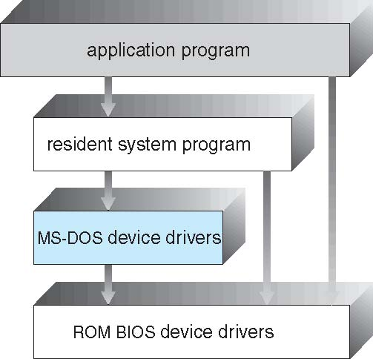
MS-DOS Layer Structure

Slide 105
Layered Approach
The operating system is divided into a number of layers (levels), each built on top of lower layers. The bottom layer (layer 0), is the hardware; the highest (layer N) is the user interface.
With modularity, layers are selected such that each uses functions (operations) and services of only lower-level layers

Slide 106
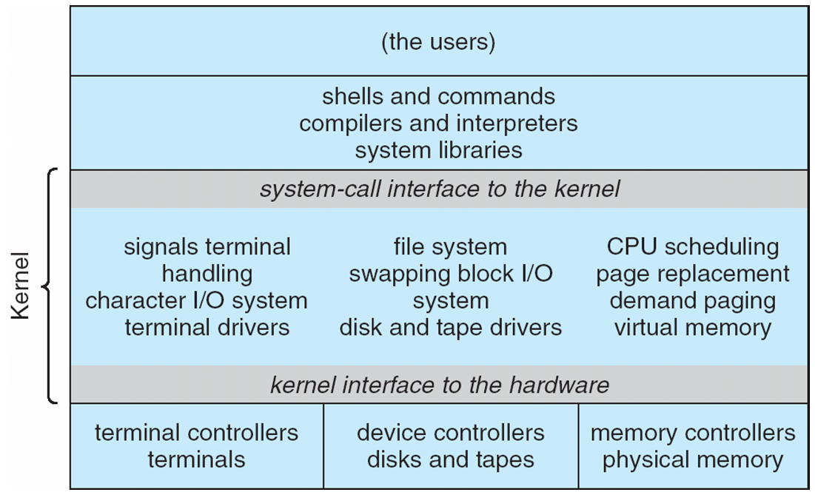
Traditional UNIX System Structure

Slide 107
UNIX
UNIX – limited by hardware functionality, the original UNIX operating system had limited structuring. The UNIX OS consists of two separable parts
Systems programs
The kernel
Consists of everything below the system-call interface and above the physical hardware
Provides the file system, CPU scheduling, memory management, and other operating-system functions; a large number of functions for one level

Slide 108
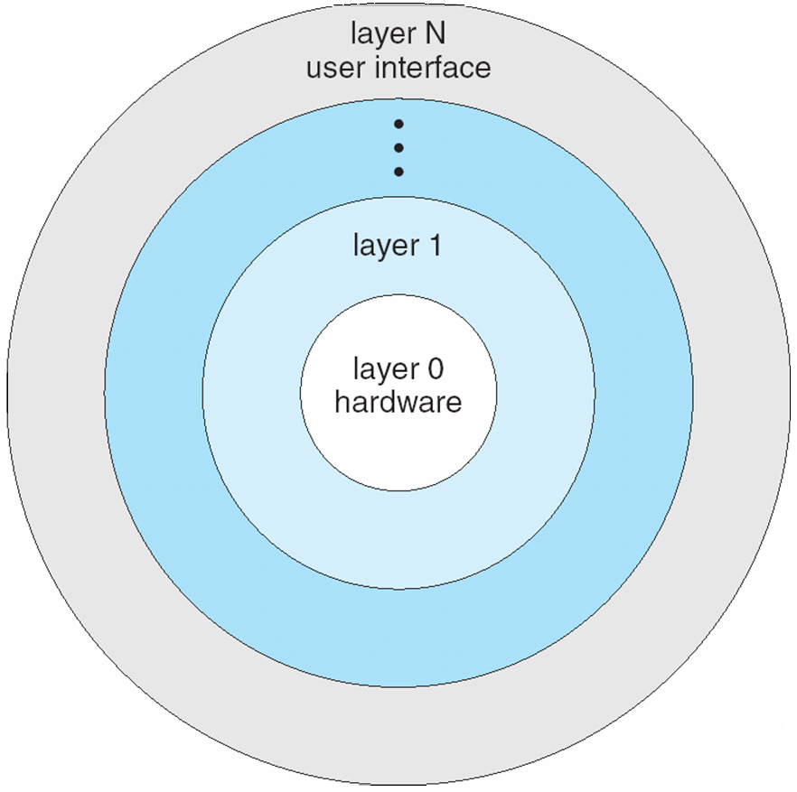
Layered Operating System

Slide 109
Microkernel System Structure
Moves as much from the kernel into “user” space
Communication takes place between user modules using message passing
Benefits:
Easier to extend a microkernel
Easier to port the operating system to new architectures
More reliable (less code is running in kernel mode)
More secure
Detriments:
Performance overhead of user space to kernel space communication

Slide 110
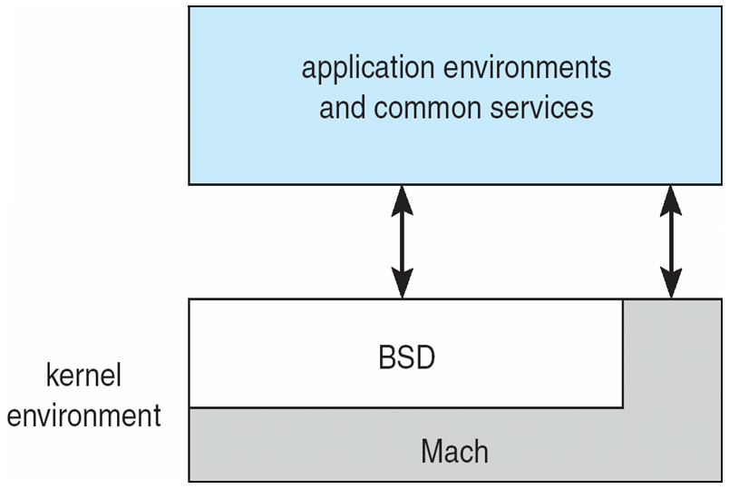
Mac OS X Structure

Slide 111
Modules
Most modern operating systems implement kernel modules
Uses object-oriented approach
Each core component is separate
Each talks to the others over known interfaces
Each is loadable as needed within the kernel
Overall, similar to layers but with more flexible

Slide 112
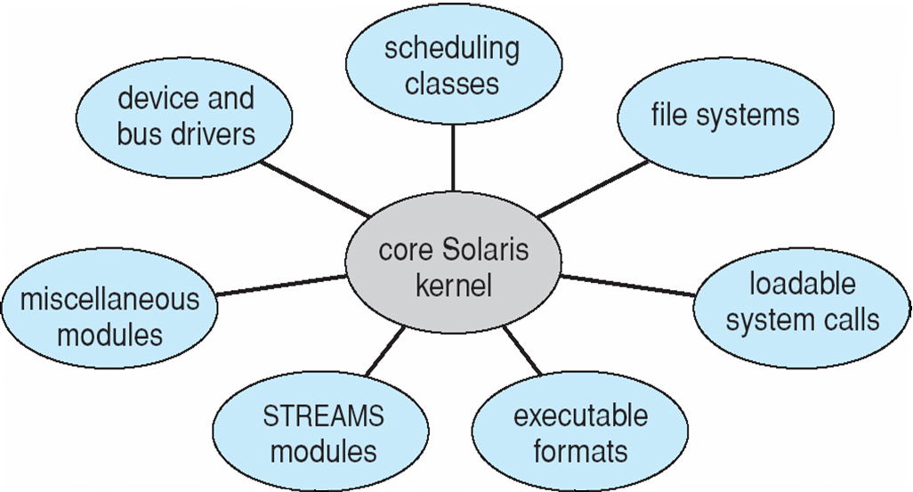
Solaris Modular Approach

Slide 113
Virtual Machines
A virtual machine takes the layered approach to its logical conclusion. It treats hardware and the operating system kernel as though they were all hardware.
A virtual machine provides an interface identical to the underlying bare hardware.
The operating system host creates the illusion that a process has its own processor and (virtual memory).
Each guest provided with a (virtual) copy of underlying computer.

Slide 114
Virtual Machines History and Benefits
First appeared commercially in IBM mainframes in 1972
Fundamentally, multiple execution environments (different operating systems) can share the same hardware
Protect from each other
Some sharing of file can be permitted, controlled
Commutate with each other, other physical systems via networking
Useful for development, testing
Consolidation of many low-resource use systems onto fewer busier systems
“Open Virtual Machine Format”, standard format of virtual machines, allows a VM to run within many different virtual machine (host) platforms

Slide 115
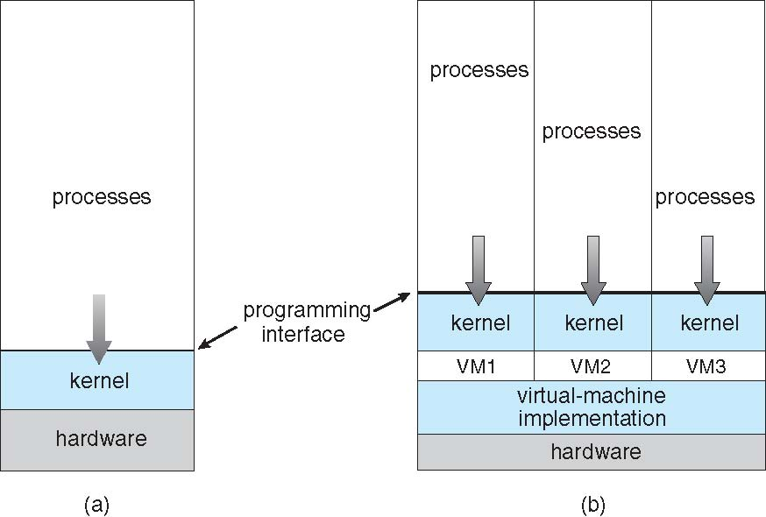
Virtual Machines (Cont.)
(a) Nonvirtual machine (b) virtual machine

Slide 116
Para-virtualization
Presents guest with system similar but not identical to hardware
Guest must be modified to run on paravirtualized hardware
Guest can be an OS, or in the case of Solaris 10 applications running in containers

Slide 117
Virtualization Implementation
Difficult to implement – must provide an exact duplicate of underlying machine
Typically runs in user mode, creates virtual user mode and virtual kernel mode
Timing can be an issue – slower than real machine
Hardware support needed
More support-> better virtualization
i.e. AMD provides “host” and “guest” modes

Slide 118
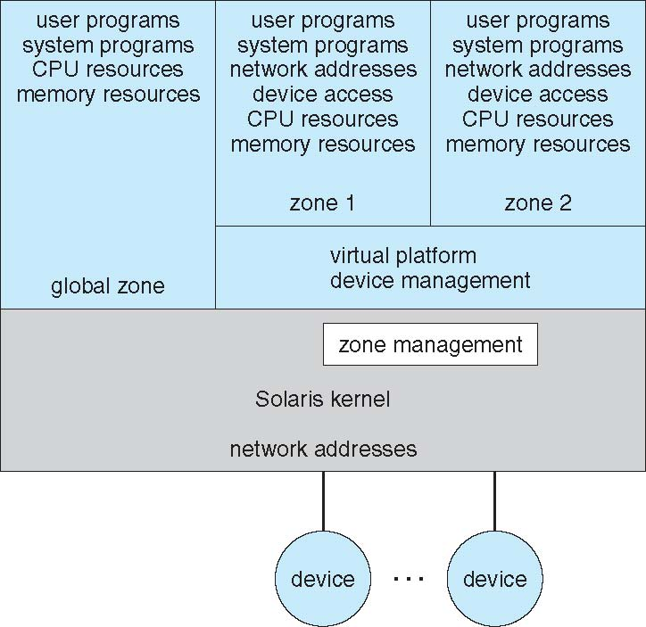
Solaris 10 with Two Containers

Slide 119
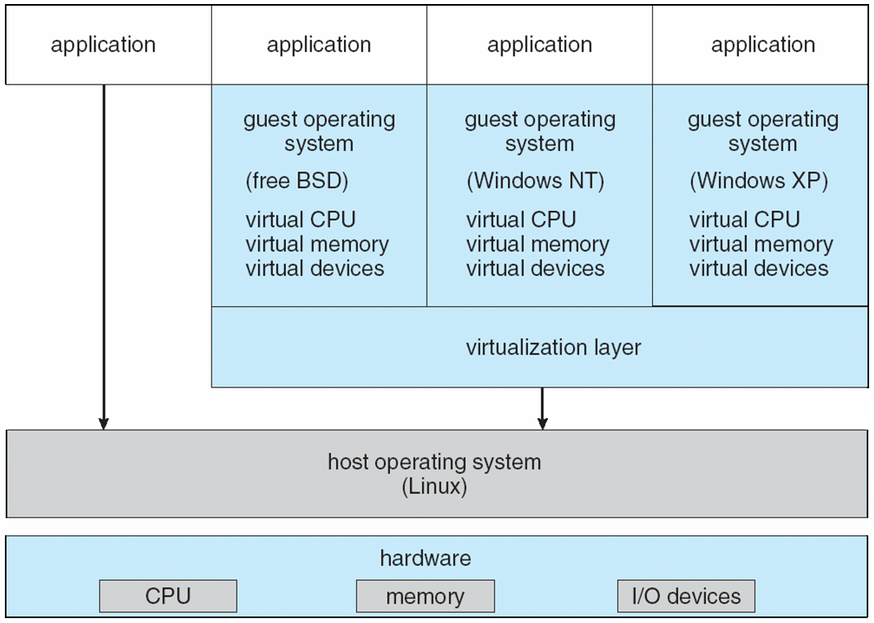
VMware Architecture

Slide 120
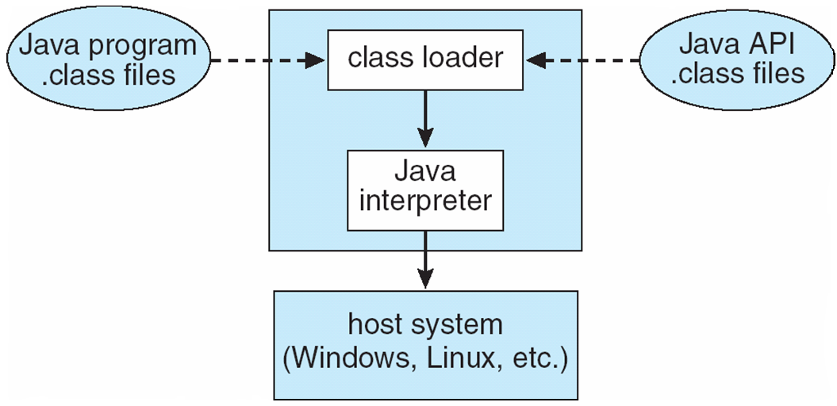
The Java Virtual Machine

Slide 121
Operating-System Debugging
Debugging is finding and fixing errors, or bugs
OSes generate log files containing error information
Failure of an application can generate core dump file capturing memory of the process
Operating system failure can generate crash dump file containing kernel memory
Beyond crashes, performance tuning can optimize system performance
Kernighan’s Law: “Debugging is twice as hard as writing the code in the first place. Therefore, if you write the code as cleverly as possible, you are, by definition, not smart enough to debug it.”
DTrace tool in Solaris, FreeBSD, Mac OS X allows live instrumentation on production systems
Probes fire when code is executed, capturing state data and sending it to consumers of those probes

Slide 122
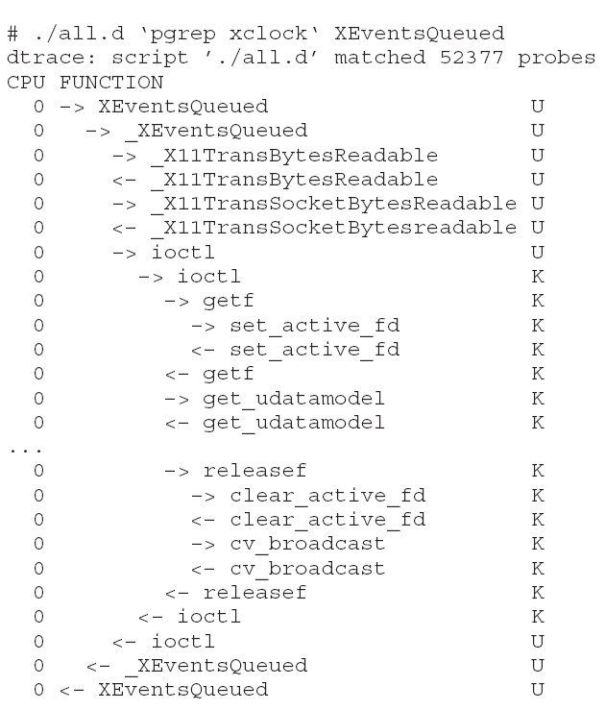
Solaris 10 dtrace Following System Call

Slide 123
Operating System Generation
Operating systems are designed to run on any of a class of machines; the system must be configured for each specific computer site
SYSGEN program obtains information concerning the specific configuration of the hardware system
Booting – starting a computer by loading the kernel
Bootstrap program – code stored in ROM that is able to locate the kernel, load it into memory, and start its execution

Slide 124
System Boot
Operating system must be made available to hardware so hardware can start it
Small piece of code – bootstrap loader, locates the kernel, loads it into memory, and starts it
Sometimes two-step process where boot block at fixed location loads bootstrap loader
When power initialized on system, execution starts at a fixed memory location
Firmware used to hold initial boot code

Slide 125
End of Chapter 2

